Slide 1
Abstract
The ASHAs have been actively participating in the COVID-19 household surveys and screening inter-state passengers, migrant workers, and others in the community for symptoms of COVID-19.
The one-time survey was carried out to identify households with senior citizens, persons with co-morbidities, and immuno-compromised individuals.
The survey has helped in recognizing the increased vulnerability of these population groups to COVID-19. As a part of the survey, the ASHA workers regularly monitor such high-risk groups in their area.
They also do follow-up visits varying from once a day in the containment zones to once every 15 days in other areas. They also visit the houses of persons expressing complaints of ILI and SARI symptoms and help connect them to the State Health Department. To help them conduct the survey we have proposed a digital solution called “Aarogya Patrika App” and an Asha Admin panel.

Slide 2
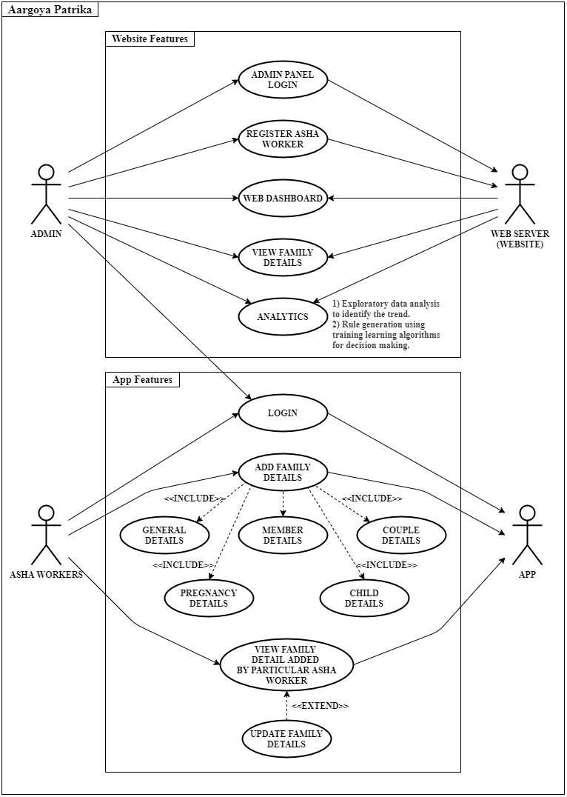
SYSTEM DESIGN
The Smart ASHA Pregnancy Monitoring System has a client-server model. It has specific software and hardware architecture. The main task is to integrate these two components to work together.
Software Architecture: The software architecture is comprised of the database, server and the client application.
Database: The database consists of a number of tables; some are fixed while some are created dynamically. These tables storing the data are implemented in MongoDB. MongoDB database is used as it is easy to use, fast and can store large amount of data efficiently requiring a little configuration.
Client Application: “The Aarogya Patrika” application is developed in Android studio framework. The application provides an efficient user interface for all the ASHA workers. Android devices being the most popular and affordable of the devices in the world, the android platform was chosen for this system. Moreover, programming in android is easy, user friendly and android has excellent data connectivity.
Server The server is deployed on Heroku as it is robust, free and easy to deploy
Hardware Architecture: The basic hardware requirement for the system is any device having access to the internet connection which can run the “Aarogya Patrika” app and a server to store the database and host the Smart ASHA website.

Slide 3
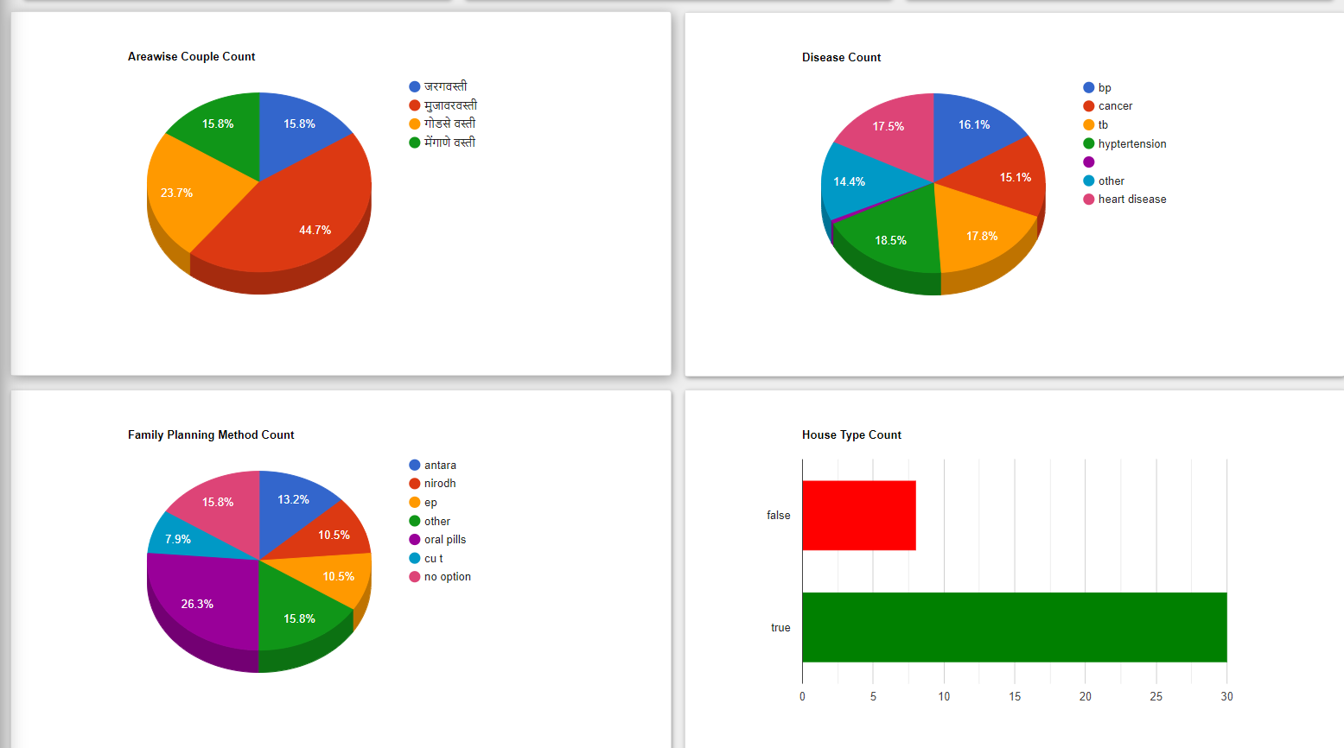
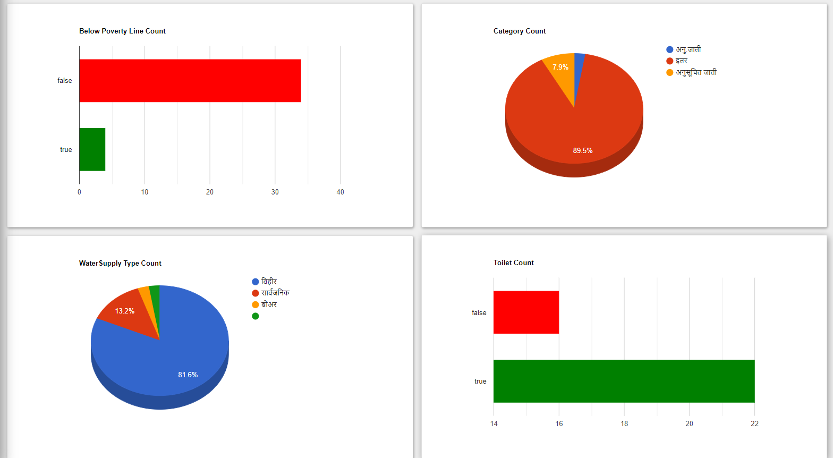
Login Page for ASHA: The application is made exclusively for ASHA workers. To prevent the non-authorized users from using the application, ASHA has to login with the username and password given to her by the medical supervisor working at the Primary Health Care centre. On click of the login button, the asynchronous process fetches the personal information of ASHA like her name, contact number, village id and stores the session in local storage for offline use.
Data Visualization: Efficient, meaningful data analysis is at the core of some of today’s most important medical studies. It’s also essential for physicians, nurses, and other health professionals during their day-to-day practice as they interact with health interfaces and databases, generate reports, and review patient information and trends. But a mountain of data is of little use without data visualization. Data visualization brings the most important takeaways in the health industry into focus, helps us identify patterns and correlations, and makes data analysis more efficient.
For all of these reasons, it’s safe to say that the health industry today could hardly survive without data visualization.
Dashboards that help medical professionals quickly analyze large sets of data can save time, and can even save lives. The graphs and charts are custom made, interactive and customizable according to the data viewer wish to visualize.

Slide 4
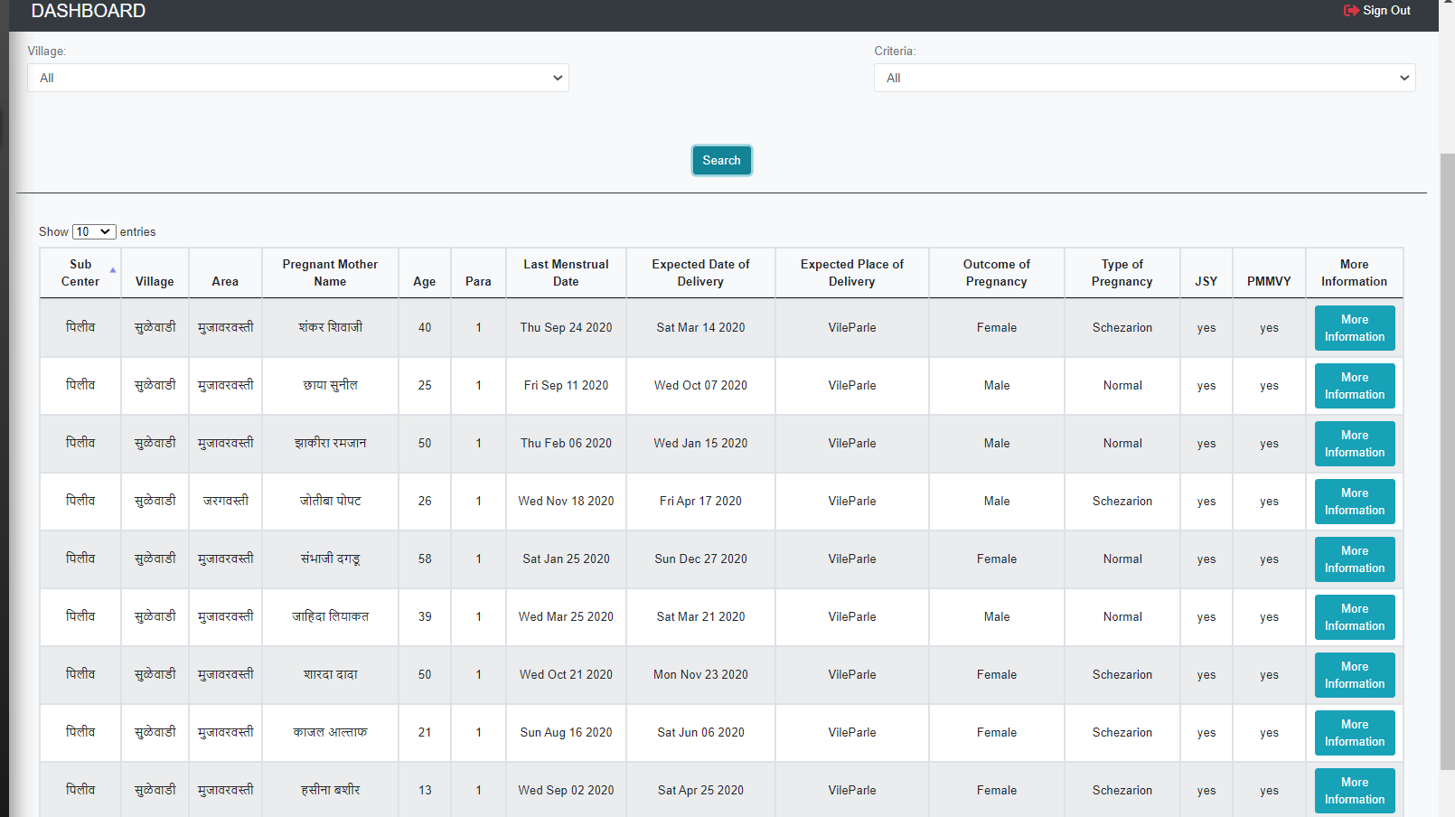
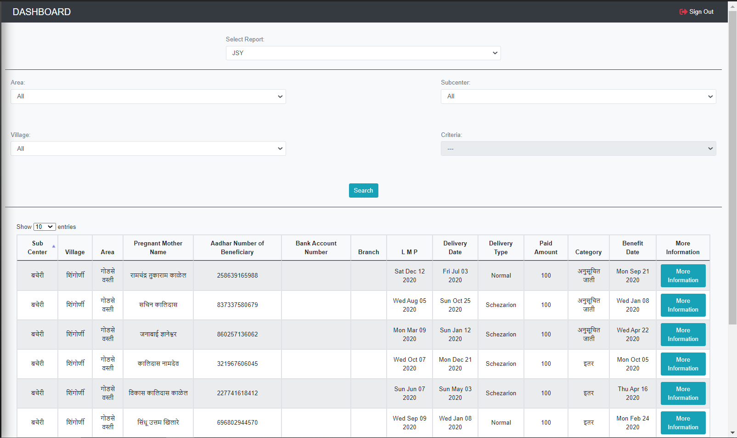
List of registered pregnant women:
The data of pregnant women with high-risk pregnancies; , such as swelling in the face or hands, low or high blood pressure, or convulsions and women in their third trimester are shown. Pregnant women in the who are attending antenatal care (ANC) visits at the hospital are also shown. Using the data, they can be consulted and educated on the importance of ANC services and can refer to them to Village Health Nutrition Days (VHNDs) which are much closer to their homes .
List of pregnant women getting benefit of JSY and PMMYY: The beneficiary would be required to fill up the prescribed scheme forms for registration and claim of the instalment and submit the same at the Anganwadi Centre/ approved Health facility.
Family Planning Counselling: The list of family planning method planning used by the couples and details about Family Planning Counselling is available on the portal and accordingly assist ASHAs to Provides antenatal care, family planning, and immunizations in villages
List of registered pregnant women
JSY and PMMYY details

Slide 5
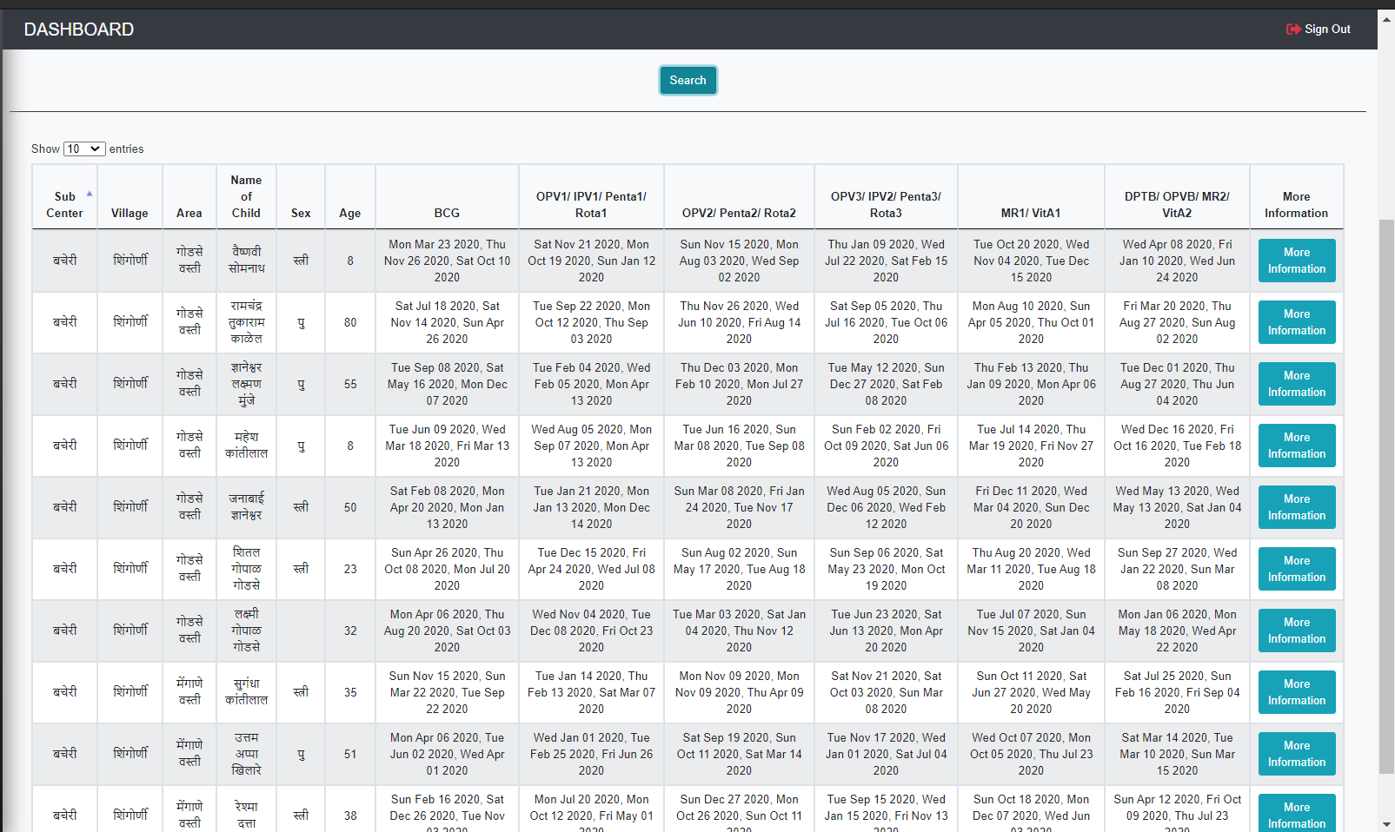
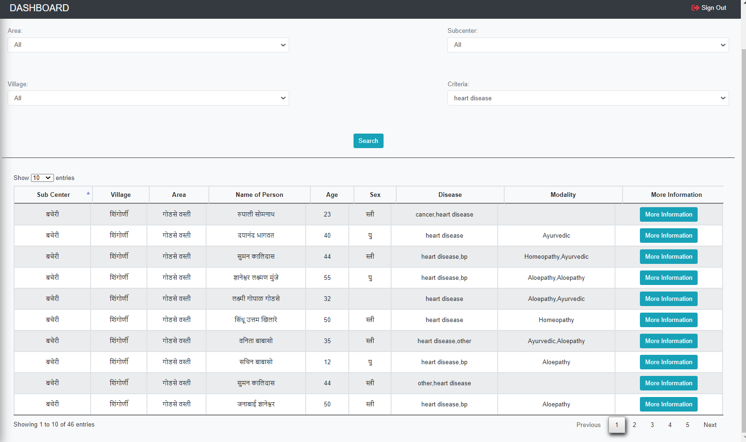
Immunization: The ASHA enters the vaccines up to an year that have been given to child. The first cycle of immunization consists of vaccine doses of BCG, Hepatitis B (Birth, 1, 2, and 3), OPV (0, 1, 2 and 3), DPT (1, 2, 3); or equivalent. The pregnant women who are registered by ASHA already and who have now surpassed the due date will appear in a list in this activity. This will make it easier for ASHA to identify newborns and get them registered for the immunization. Not taking the vaccines, pose a high risk on the newborns. It is thus very essential to ensure that every newborn is vaccinated properly.
Records of disease prevalent and different modality used:
NCDs(Non-Communicable Diseases) are diseases of long duration. These are non-infectious conditions that cannot be transmitted to other individuals. Five Common NCDs on which ASHAs are trained: Hypertension, Diabetes, Cervical Cancer, Breast Cancer and Oral Cancer . A list of all the people with NCDs are shown to the admin. This will help to facilate health services; links community members and health facilities; provides community level health services; activist building understanding of health and right to health.
Immunization details
Different Diseases present in the area and the modality used

Slide 6
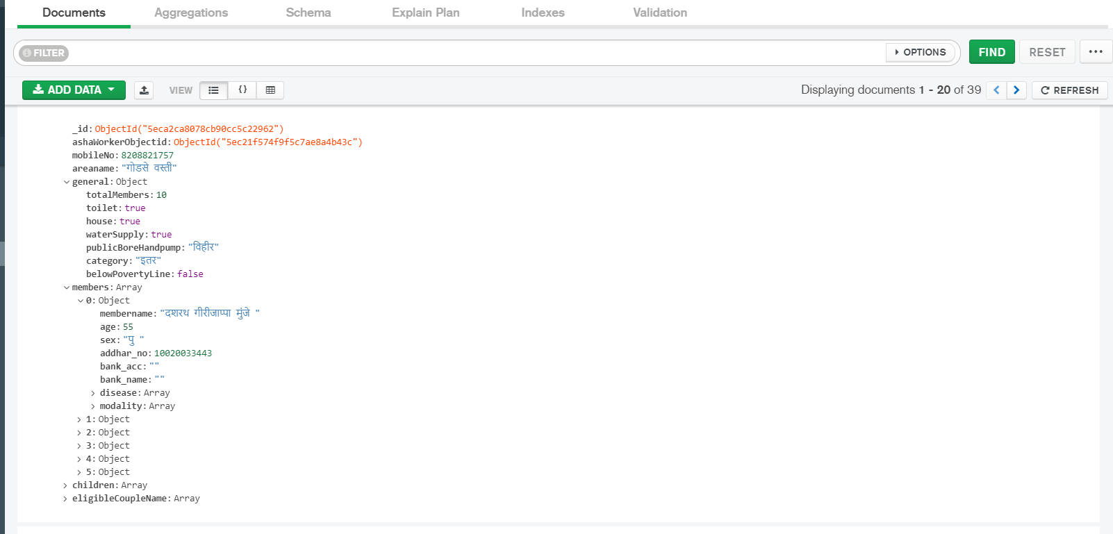
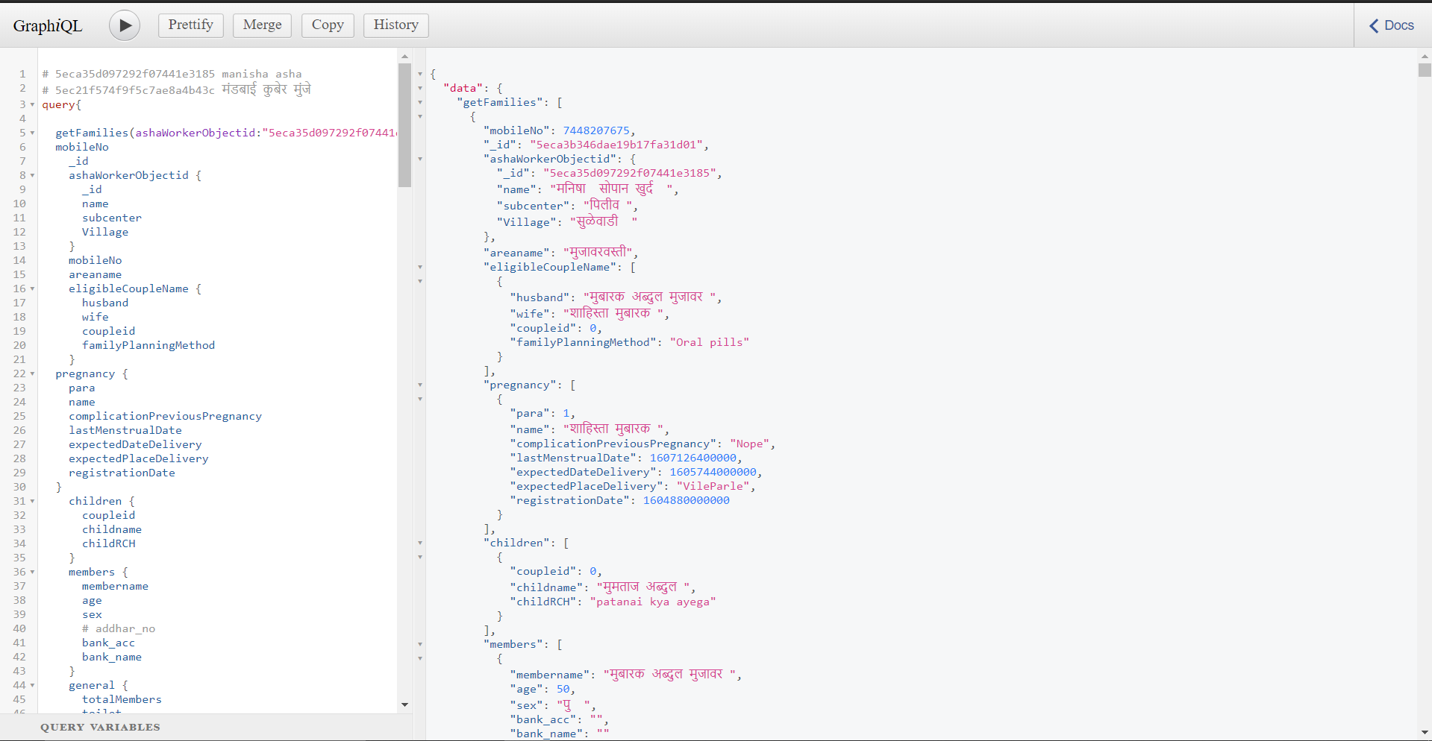
MongoDB: NoSQL databases were created in response to the limitations of traditional relational database technology. When compared to relational databases, NoSQL databases are often more scalable and provide superior performance. In addition, the flexibility and ease of use of their data models can speed development in comparison to the relational model, especially in the cloud computing environment.
Each specific type of NoSQL database has different strengths, but all share fundamental characteristics that allow them to:
Handle large volumes of data at high speed with a scale-out architecture
Store unstructured, semi-structured, or structured data
Enable easy updates to schemas and fields
Be developer-friendly
Take full advantage of the cloud to deliver zero downtime
These capabilities provide users with many advantages compared to relational databases.
A NoSQL Database with necessary aggregation pipelines highly optimized for high speed data retrieval operations
GraphQL: At its core, GraphQL is a language for querying databases from client-side applications. On the backend, GraphQL specifies to the API how to present the data to the client. GraphQL redefines developers’ work with APIs offering more flexibility and speed to market; it improves client-server interactions by enabling the former to make precise data requests and obtain no more and no less, but exactly what they need.
GraphQL advantages:
Good fit for complex systems and micro services
Fetching data with a single API call.
Auto generating API documentation
Detailed error messages
A GraphQL API for interaction of the Mobile App and website with the MongoDB Database

Slide 7
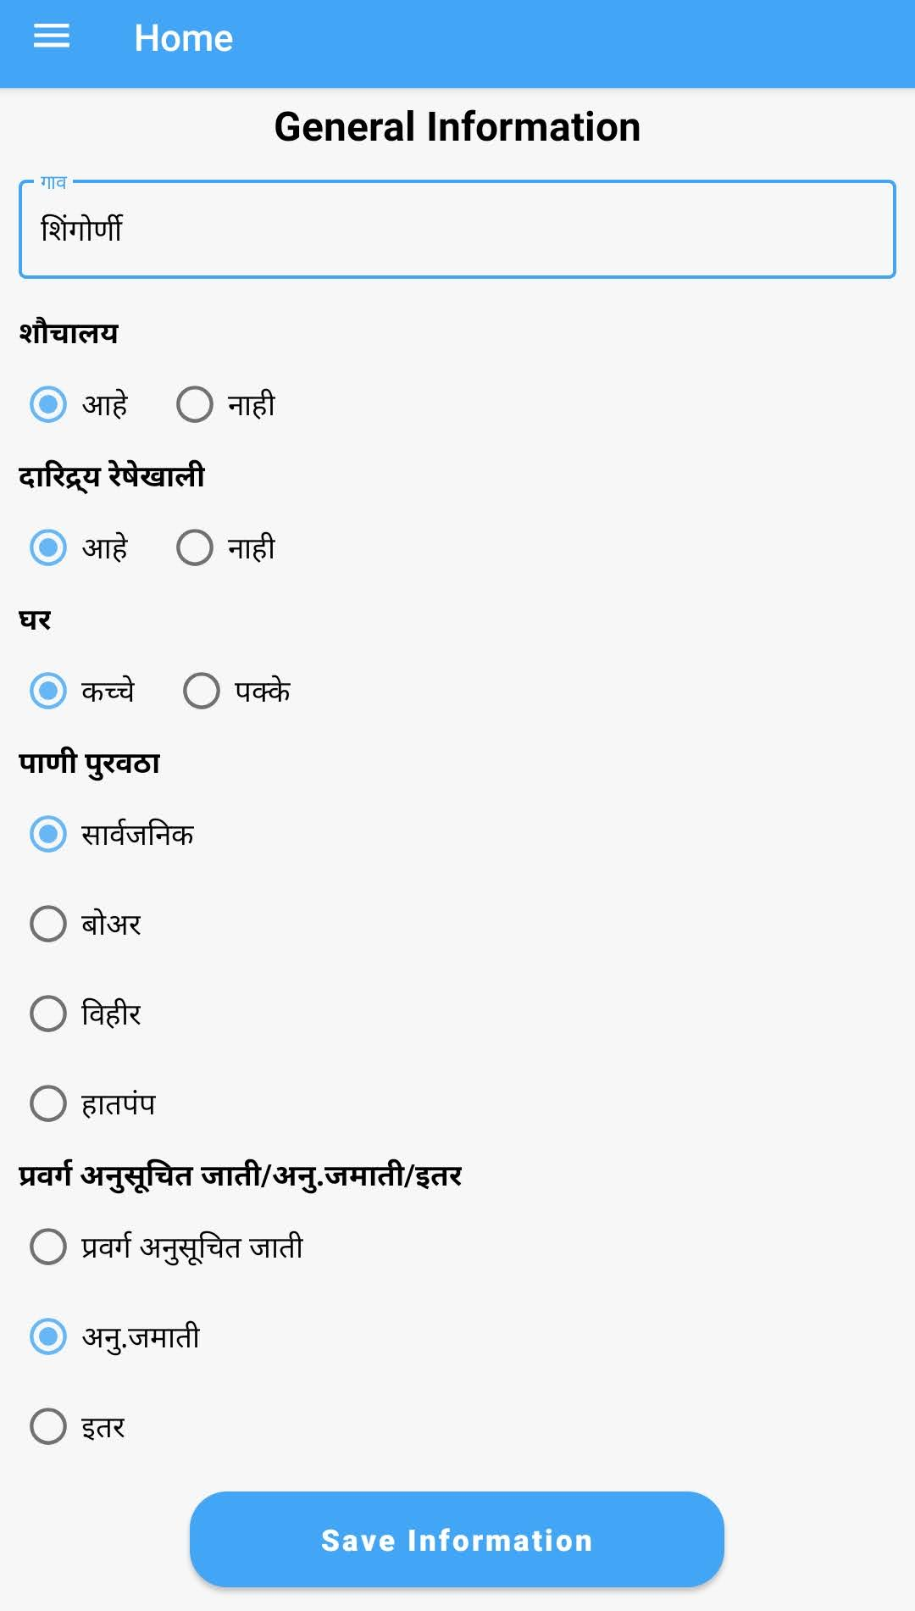
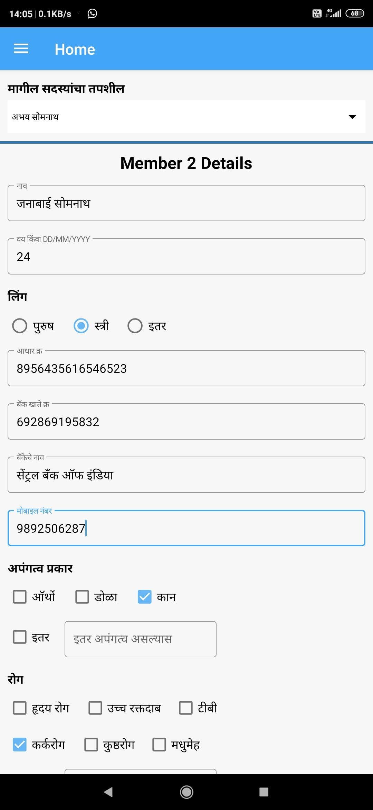
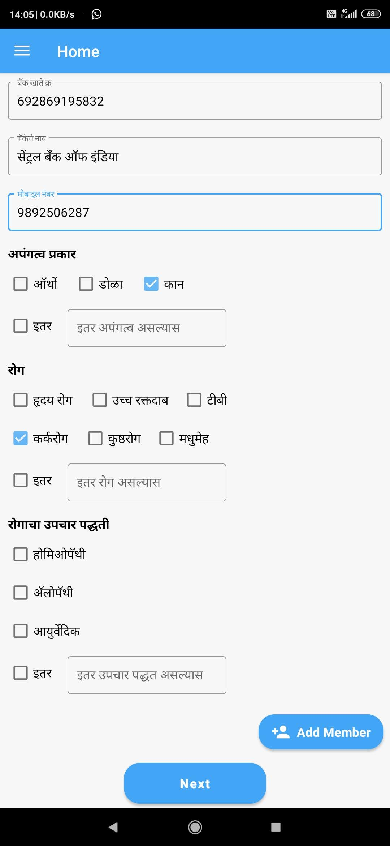
Household and Member details collected by ASHAs

Slide 8
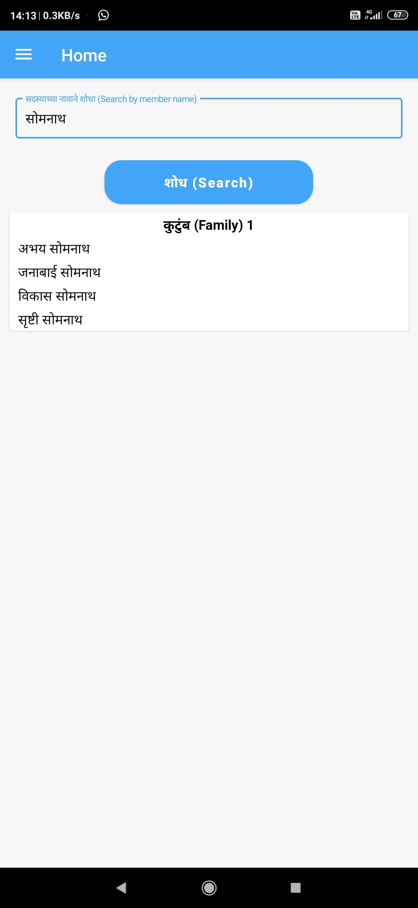
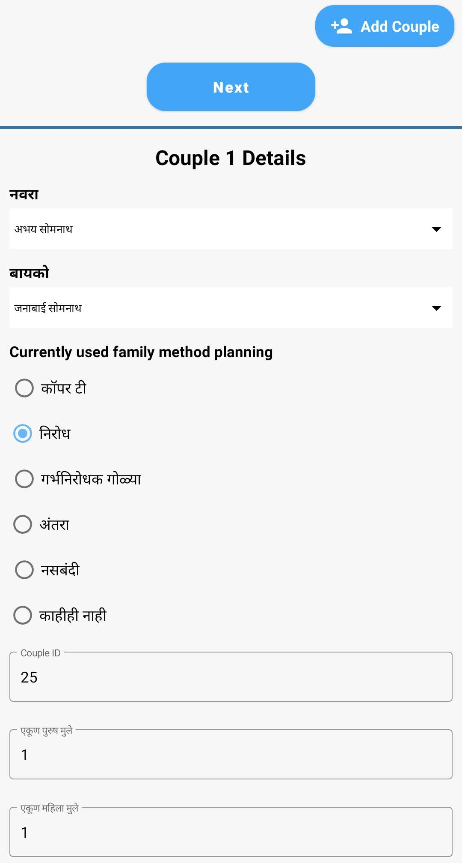
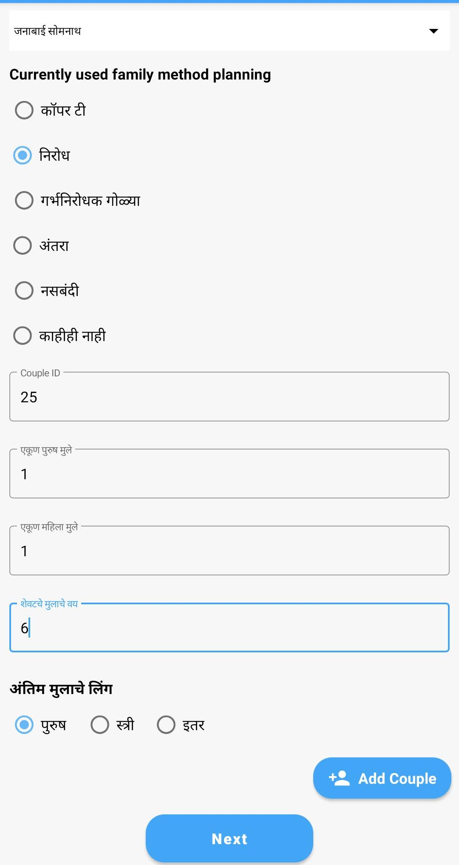
Couple Information collected by ASHAs

Slide 9
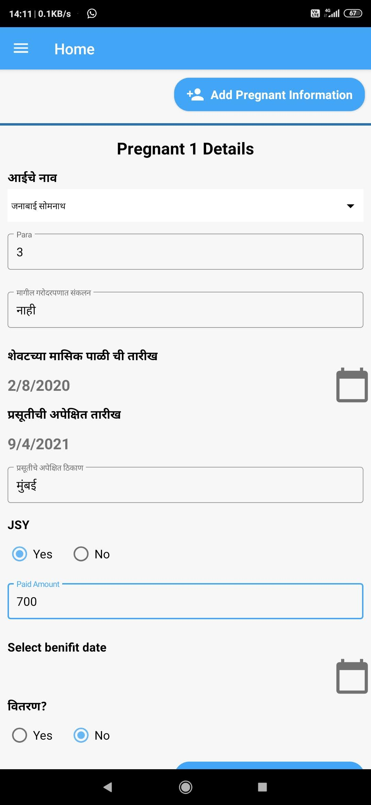
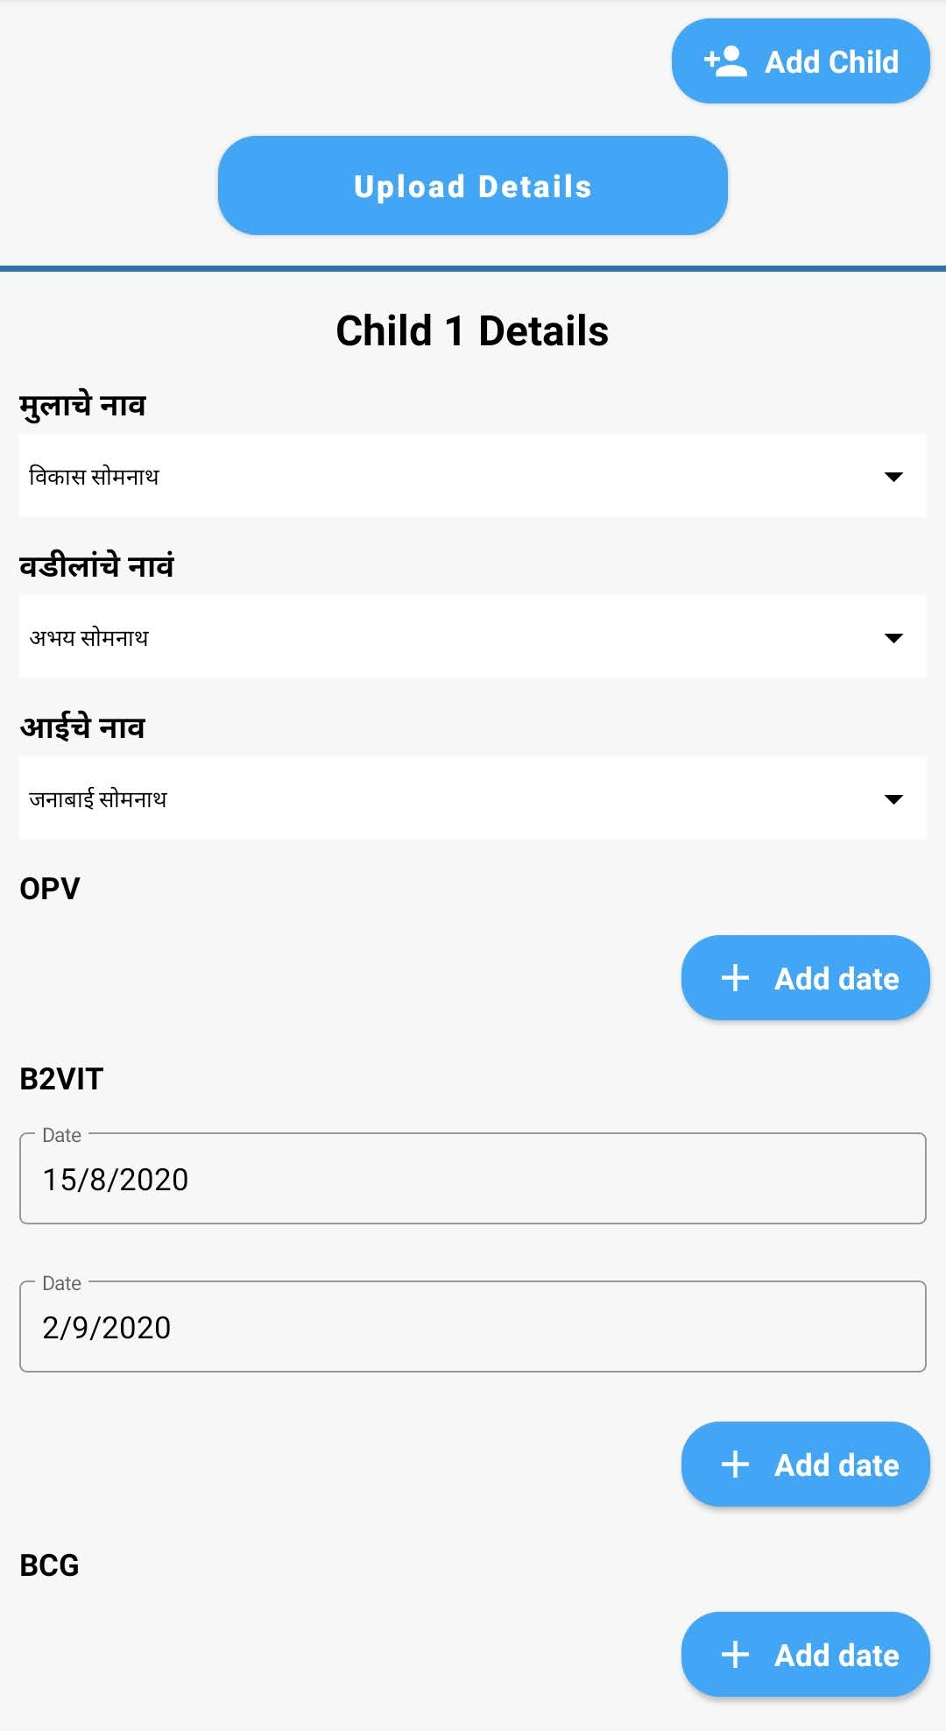
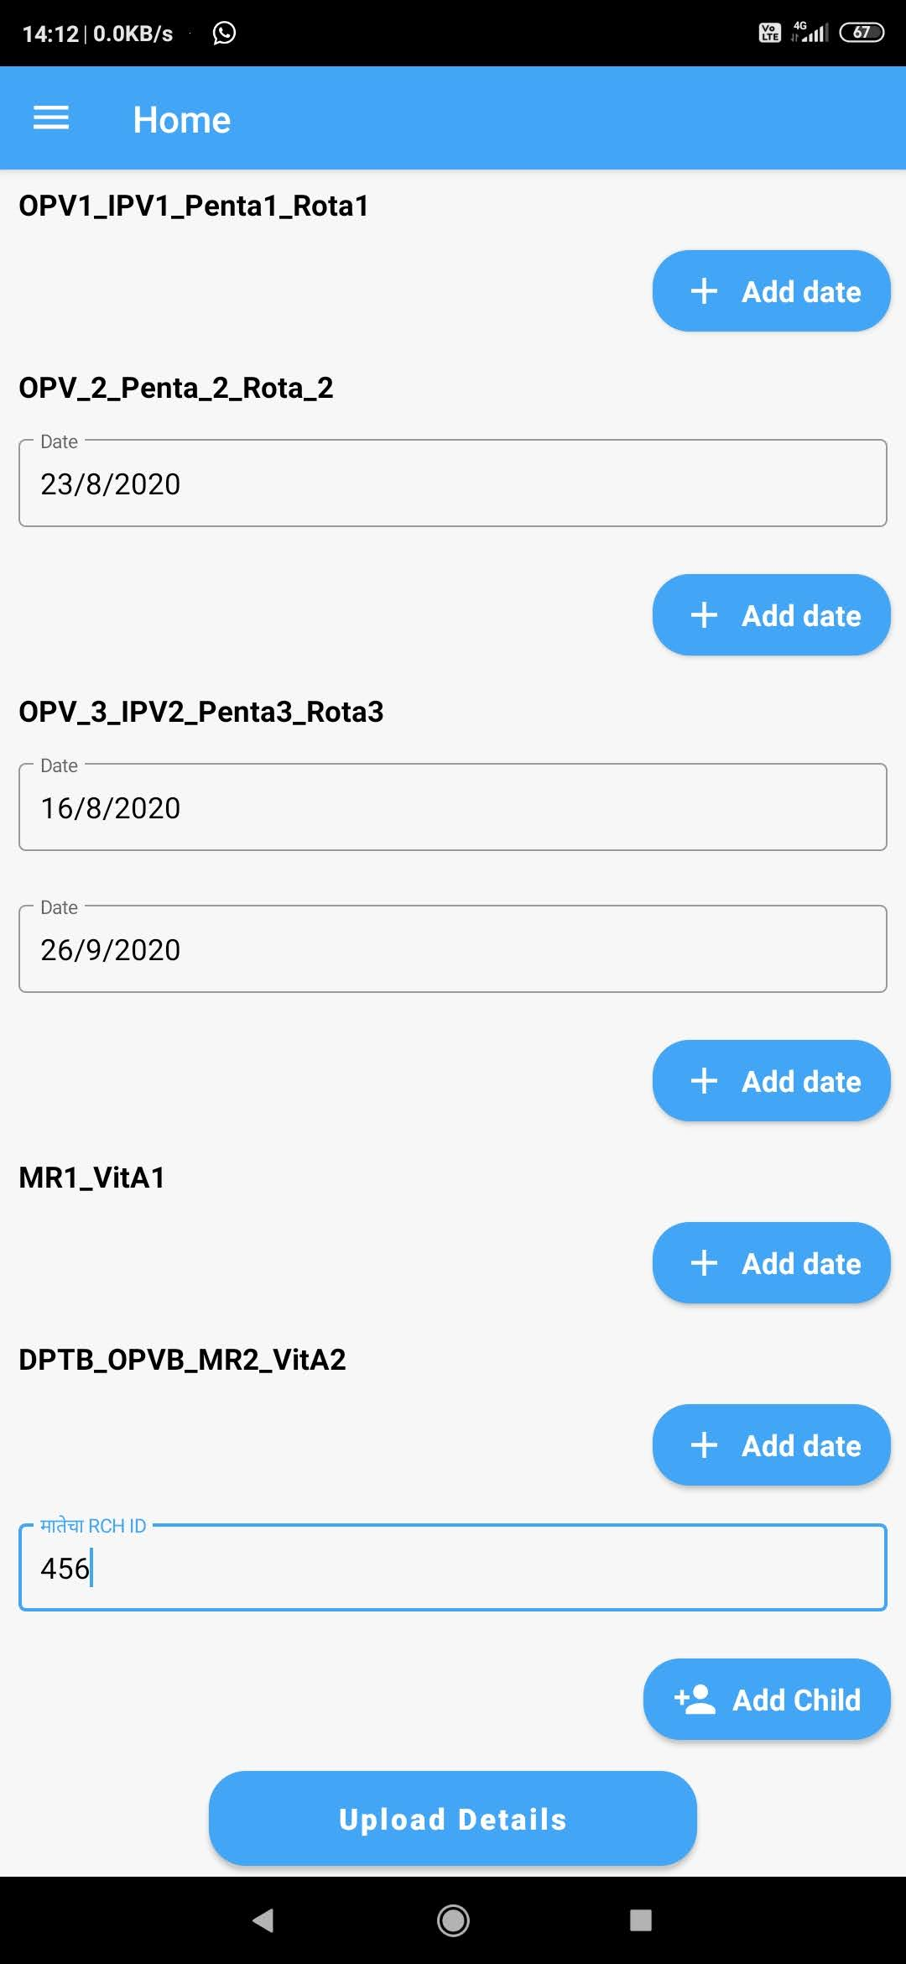
Pregnancy and child details

